Slide 1

UNDERSTANDING CUSTOMERS BETTER
Customer Personality Analysis
Presented by Yasmeen

Slide 2
Customer Personality Analysis is an essential tool that helps businesses understand their ideal customers on a deeper level. By leveraging this analysis, companies can tailor products and marketing strategies, ultimately enhancing customer satisfaction and driving loyalty through data-informed decisions.
Introduction to Customer Analysis

Slide 3
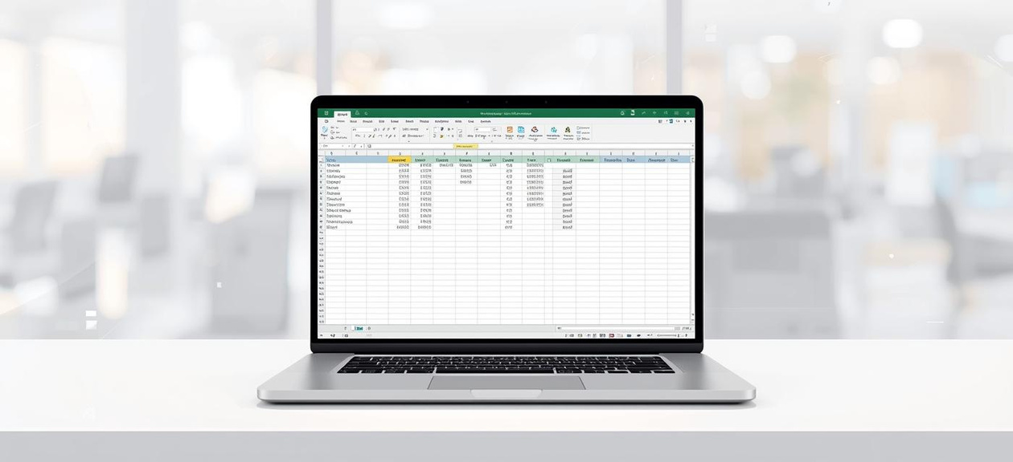
Data Cleaning Process
Removal of Duplicate Entries
Preparing Raw Data for Analysis
Clean data is essential for accurate insights, ensuring that the analysis reflects true customer behavior and preferences.
Handling Missing Values
Text Standardization

Slide 4
Derived Metrics
Age Calculation
Age Grouping
The age of customers is calculated using the formula: Age = YEAR(TODAY()) - Year_Birth, providing a clear understanding of customer demographics and life stages.
Customers are categorized into age groups (18–30, 31–45, 46–60, 60+) to facilitate targeted marketing strategies and product alignment with their specific needs and preferences.
Total Spending
Favorite Product Category
Total Spending is calculated by summing individual product category expenditures, providing insight into overall customer purchasing habits and emphasizing key areas of revenue generation.
The favorite product category is identified using advanced Excel formulas, helping businesses tailor marketing strategies to focus on high-demand items that resonate with customers.

Slide 5


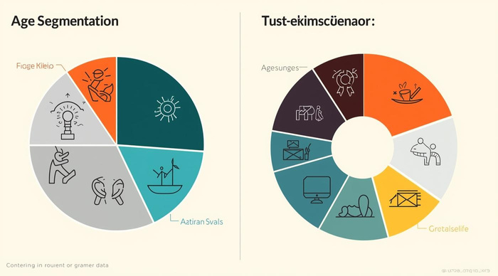
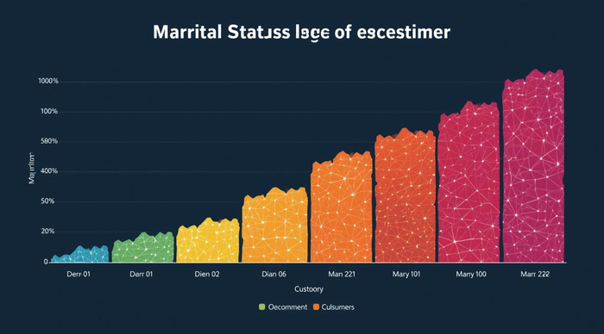
Customer Segmentation for Targeted Insights
Age Groups
Marital Status
Customers divided into life stage categories.
Categorization based on relationship dynamics.
Education Levels
Income Ranges
Insights based on educational backgrounds.
Grouping customers by income status.

Slide 6

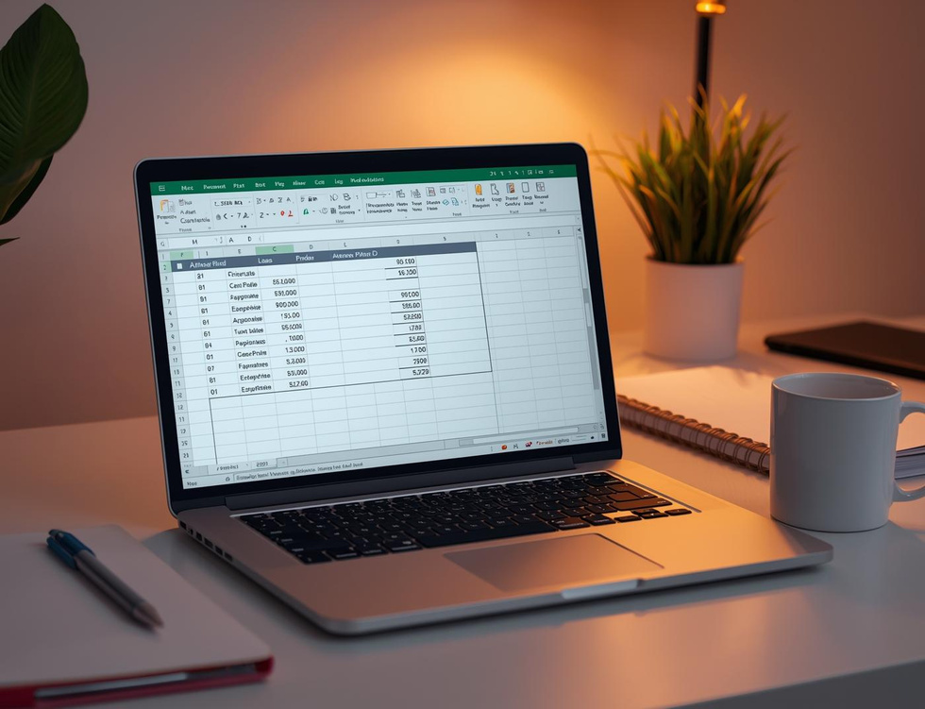

Statistical Analysis
SUM Function
AVERAGE Function
MAX Function
The SUM function aggregates values, providing totals for essential metrics in analysis.
The AVERAGE function calculates mean values, offering insights into customer spending patterns.
The MAX function identifies highest values, crucial for uncovering top spending categories.

Slide 7
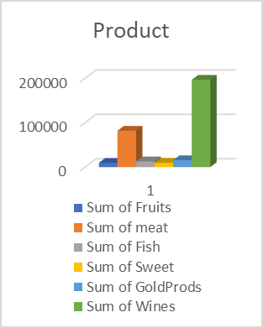
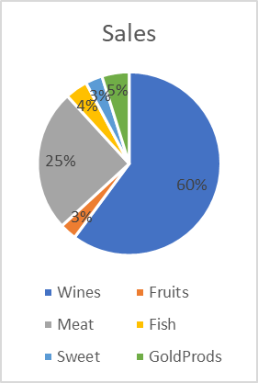
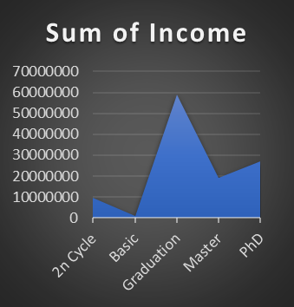
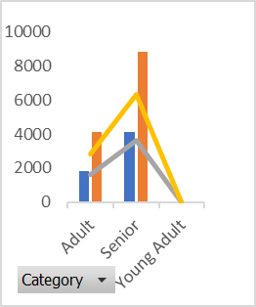

Exploratory Data Analysis: Insights from Customer Spending
Product Analysis
Sales Overview
Income Insights
Purchase Behavior
Highlights trends across different buying channels.

Slide 8
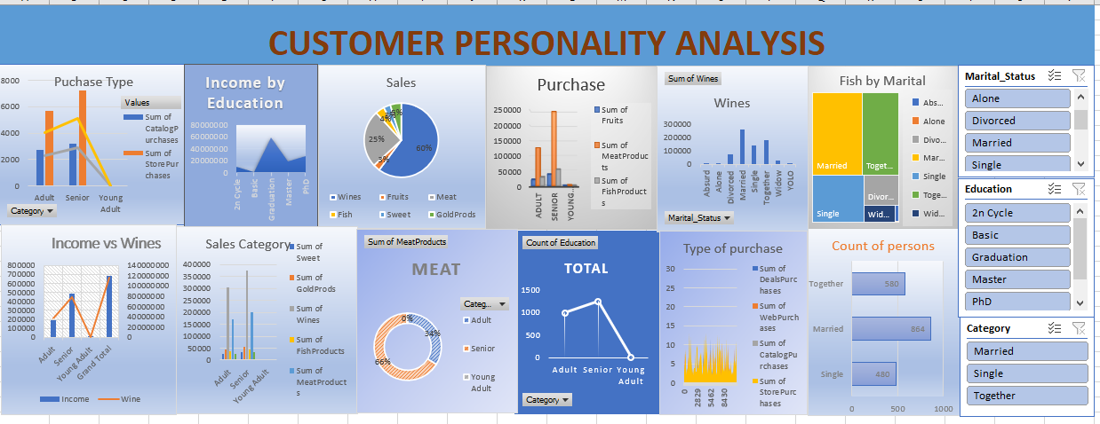
DashBoard

Slide 9
Formula-Based Analysis: Quantifying Customer Data
Key Excel Functions Explained
Logical Functions for Analysis
Lookup Functions for Data Retrieval
Understanding the essential functions like SUM, AVERAGE, and MAX helps aggregate customer data effectively for deeper insights.
Using IF, AND, and OR functions allows for conditional logic, enabling better categorization and understanding of customer behaviors.
VLOOKUP and INDEX/MATCH functions are crucial for retrieving specific customer data, ensuring accurate analysis and segmentation insights.

Slide 10
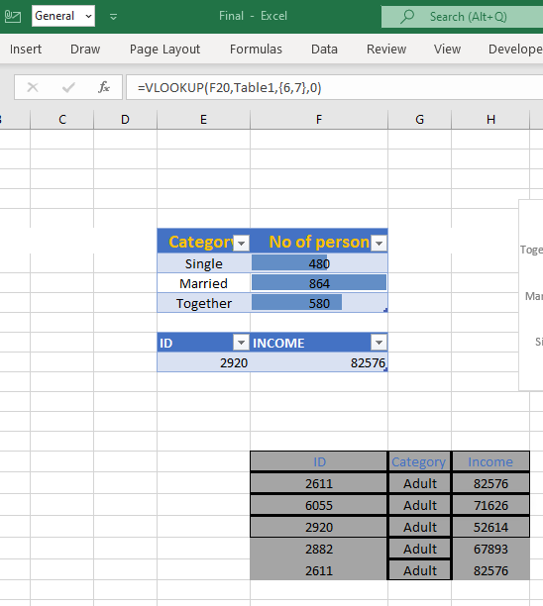
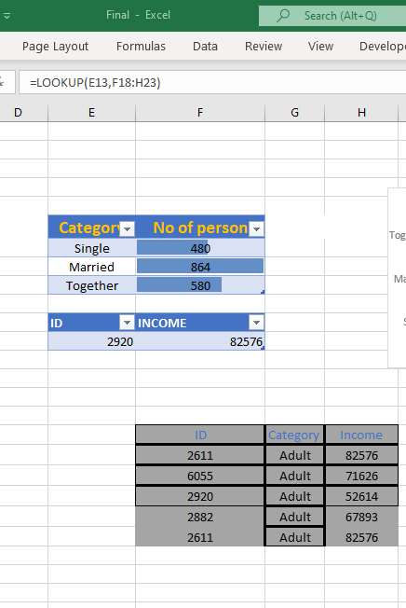
VLOOK UP AND LOOK UP

Slide 11
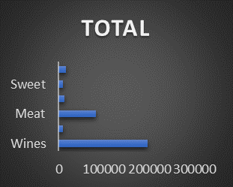
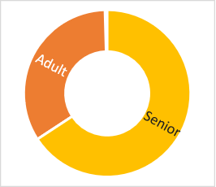
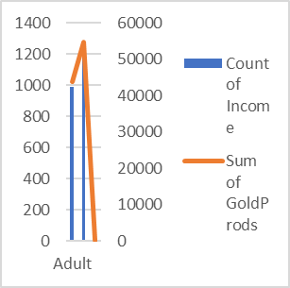
Product Spending Insights
Wine
Meat
Gold
Highest spending category in analysis.
Significant contributions to overall product sales.
Popular among high-income customers.

Slide 12
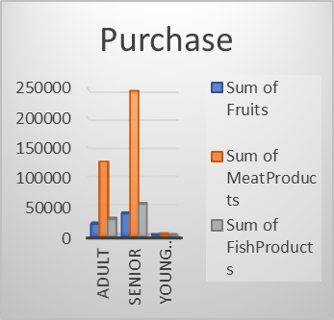
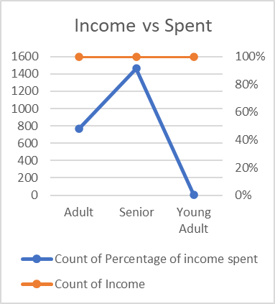
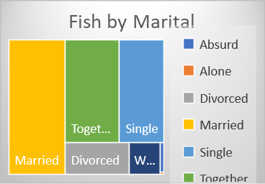
Customer Demographics Insights
Age
Income
Marital Status
Diverse age groups drive purchasing decisions.
Income levels determine spending capacity.
Marital status affects buying behavior.

Slide 13
Power Pivot Insights
Power Pivot is a powerful Excel tool that enables users to create data models and establish relationships between different data sets. This functionality allows for more complex analysis and visualizations, enhancing the overall understanding of customer behaviors and trends. By integrating multiple tables, users can uncover deeper insights from their data, enabling businesses to make informed decisions based on comprehensive analytics and refined customer segmentation.

Slide 14
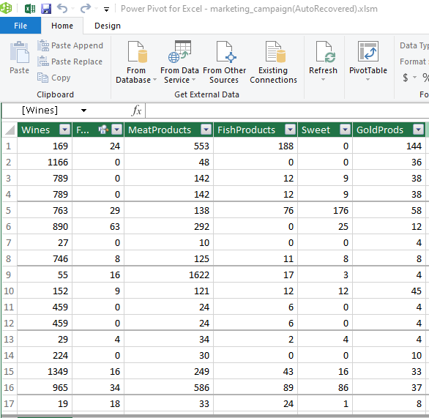
Power Pivot

Slide 15
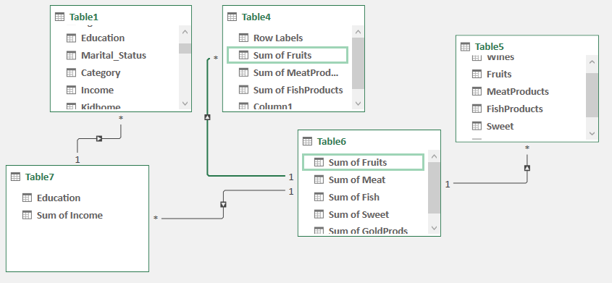
DATA MODELLING

Slide 16

Scenario Analysis Techniques
Exploring Predictive Insights with Excel
Predicting Customer Behavior with Scenario Analysis
16

Slide 17
Scenario Analysis Techniques for Business Insights
What-If Analysis
Scenario Manager
Goal Seek Function
What-If Analysis enables businesses to explore different scenarios, predicting outcomes based on varying customer behaviors, which aids in strategic decision-making and planning.
The Scenario Manager allows users to create and compare multiple scenarios quickly, providing a clear summary of how changes affect business outcomes and strategies.
The Goal Seek function identifies the necessary inputs required to achieve specific financial goals, allowing businesses to optimize revenue targets efficiently and effectively.

Slide 18
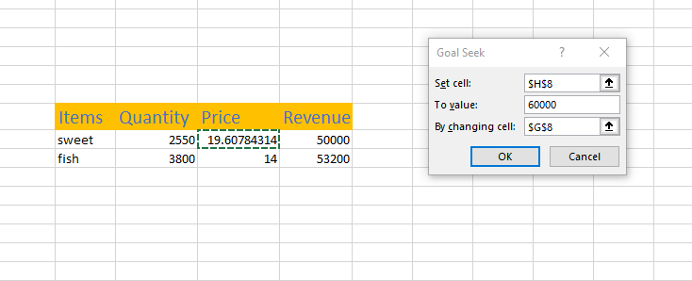
Goal seek
Your paragraph text

Slide 19
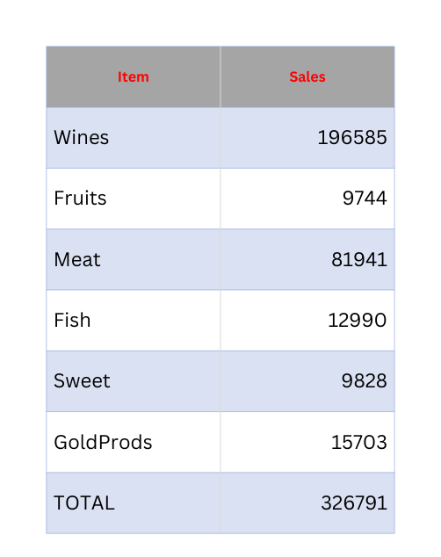
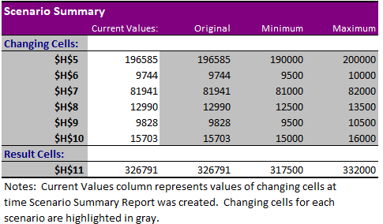
Example Scenario

Slide 20
Key Recommendations for Business Growth
Target High-Income Customers
Promote Family-Oriented Products
Enhance Online Experience
Focus on high-income wine and gold buyers with premium campaigns to increase engagement and drive sales in lucrative segments.
Create product bundles appealing to middle-aged customers and families, fostering loyalty and enhancing customer satisfaction through tailored offerings.
Improve the web-store experience for customers to drive increased online purchases and elevate overall customer experience through personalized engagement.

Slide 21
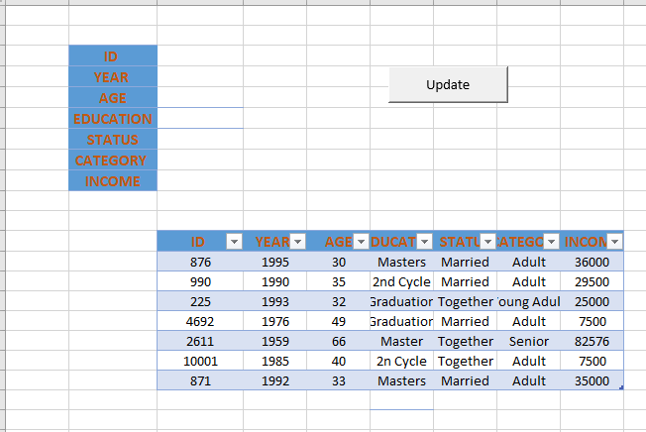
MACROS

Slide 22

Thank You

